Slide 1
PRC-2
HEART DISEASE PROGNOSIS USING MACHINE LEARNING
Area/Specialization : Machine Learning
Project Type: Application Oriented
SECTION- B
BATCH - 02
Student Name | Regd. No. | No. of meetings with guide
N. VINITHA | 15L31A05C2 | 30
K. SHILY | 15L31A0599 | 29
R. HINDUJA | 15L31A05G2 | 28
M. VENKATA SWARNESH | 15L31A05B3 | 27
K V S S HANEESH KRISHNA | 15L31A0581 | 27
GUIDE: Mr. M. SRINIVASA RAO(Asst. Prof.)
DEPARTMENT OF CSE

Slide 2
Motivation/Origin
PRC-2
The rapid growth in the field of data analysis, plays an important role in the healthcare research.
Due to large amount of data growth in biomedical and healthcare field, the need for providing accurate analysis of medical data has benefits like early detection, patient care and community services.
Statistical data display the lethalness of cardiovascular or heart diseases by revealing the percentage of deaths worldwide caused due to heart attacks.
DEPARTMENT OF CSE

Slide 3
PRC-2
ABSTRACT:
In this project we will be designing a model with the help of already existing medical data from hospital and medical communities to train the system in-order to predict the possibility of a patient being diagnosed with a heart disease. The proposed model takes the factors which effect the health of a person, thus providing the accurate probability of occurrence of a heart disease is predicted considering all possibilities.
PROBLEM STATEMENT:
Now-a-days heart disease is one of the most important causes of death in the world. So its early prediction and diagnosis is important in medical field, which could help in on time treatment, decreasing health costs and decreasing death caused by it.
DEPARTMENT OF CSE

Slide 4
PRC-2
EXISTING SYSTEM:
Diagnosis of a patient’s condition solely depends upon the doctor’s intuition and patients previous records.
The practical use of various collected data is time consuming.
Very few systems use the available clinical data for prediction purposes and even if they do, they are restricted by the large number of associations rules that apply.
Among various life-threatening diseases, heart disease has garnered a great deal of attention in medical research.
DEPARTMENT OF CSE

Slide 5
PRC-2
PROPOSED SYSTEM :
The proposed system acts as a decision support system and will prove to be an aid for the physicians with the diagnosis.
High performance and approximately 80% accuracy rate compared to existing system in which manual and statistical approach is followed.
Can analyze large amounts of data.
Diagnosis is done by analyzing the entire dataset which is used to train the machine learning model.

Slide 6
Structured Abstract
PRC-2
Purpose: To provide a solution for accurate analysis of medical data to attain benefits like early detection, patient care, and community services.
Objective: The proposed system acts as a decision support system and will prove to be an aid for the physicians with the diagnosis. High performance and approximately 80% accuracy rate compared to existing system in which manual and statistical approach is followed as the diagnosis is done by analyzing the entire dataset which is used to train the machine learning model.
Methodology: Supervised Machine Learning algorithms for classification
Findings: By analyzing the entire data we came to know the relation between the features.
Practical Implementation: Using Supervised machine learning algorithms we intend to develop a model which will be helpful for physicians to analyze patient’s EMR’s to some extent to make predictions.

Slide 7
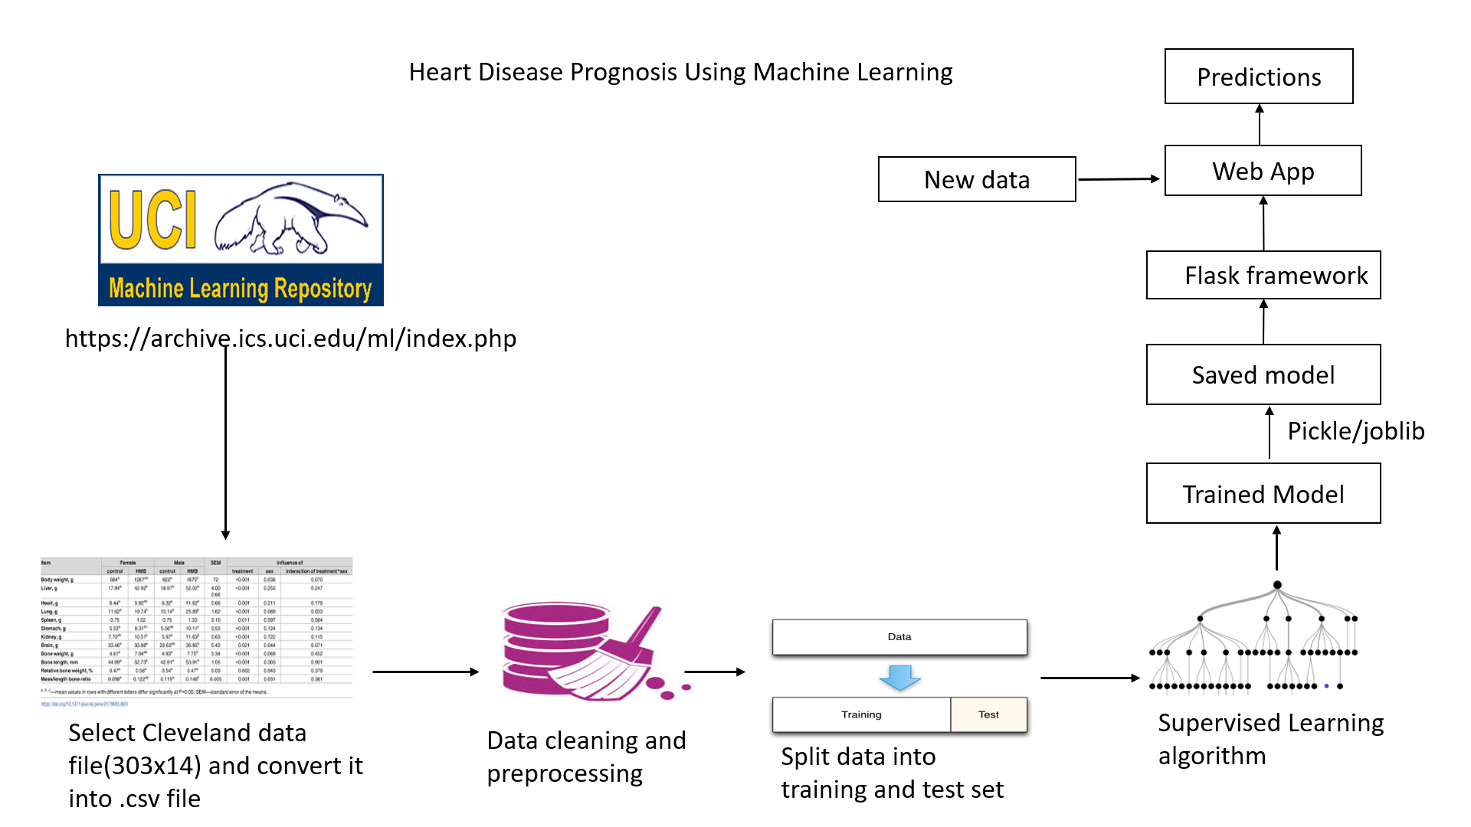
Graphical Abstract
PRC-2
Supervised Learning Algorithms used:
Logistic Regression
Naïve Bayes Classifier
Support Vector Machines
Decision tree Classifier
Random Forest Classifier
DEPARTMENT OF CSE

Slide 8
About Machine Learning: PRC-2
Machine learning is an application of artificial intelligence (AI) that provides systems the ability to automatically learn and improve from experience without being explicitly programmed. Machine learning focuses on the development of computer programs that can access data and use it learn for themselves.
The process of learning begins with observations or data, such as examples, direct experience, or instruction, in order to look for patterns in data and make better decisions in the future based on the examples that we provide. The primary aim is to allow the computers learn automatically without human intervention or assistance and adjust actions accordingly.

Slide 9
Types Of Machine Learning algorithms:
1. Supervised machine learning algorithms can apply what has been learned in the past to new data using labeled examples to predict future events. Starting from the analysis of a known training dataset, the learning algorithm produces an inferred function to make predictions about the output values. The system is able to provide targets for any new input after sufficient training. The learning algorithm can also compare its output with the correct, intended output and find errors in order to modify the model accordingly.
2. Unsupervised machine learning algorithms are used when the information used to train is neither classified nor labeled. Unsupervised learning studies how systems can infer a function to describe a hidden structure from unlabeled data. The system doesn’t figure out the right output, but it explores the data and can draw inferences from datasets to describe hidden structures from unlabeled data.
3. Reinforcement machine learning algorithms is a learning method that interacts with its environment by producing actions and discovers errors or rewards. Trial and error search and delayed reward are the most relevant characteristics of reinforcement learning. This method allows machines and software agents to automatically determine the ideal behavior within a specific context in order to maximize its performance. Simple reward feedback is required for the agent to learn which action is best; this is known as the reinforcement signal.

Slide 10
Dataset structure & description
The dataset used in this project contains 14 variables. The dependent variable that needs to be predicted, 'diagnosis', determines whether a person is healthy or suffer from heart disease. Experiments with the Cleveland database have concentrated on endeavors to distinguish disease presence (values 1, 2, 3, 4) from absence (value 0). There are several missing attribute values, distinguished with symbol '?'. The header row is missing in this dataset, so the column names have to be inserted manually.
Features information:
age - age in years (continuous feature)
gender - gender(1 = male; 0 = female) (Categorial Feature)
chestpain - chest pain type (1 = typical angina; 2 = atypical angina; 3 = non-anginal pain; 4 = asymptomatic) (categorial Feature)
bloodpressure - resting blood pressure (in mm Hg on admission to the hospital) (continuous feature)
serumcholestoral - serum cholestoral in mg/dl (continuous feature)
fasting_blood_sugar - fasting blood sugar > 120 mg/dl (1 = true; 0 = false) (ordinal feature)
electrocardiographic - resting electrocardiographic results (0 = normal; 1 = having ST-T; 2 = hypertrophy) (ordinal feature)
max_heart_rate - maximum heart rate achieved (continuous feature)
induced_angina - exercise induced angina (1 = yes; 0 = no) (ordinal feature)
ST_depression - ST depression induced by exercise relative to rest (continuous feature)
slope - the slope of the peak exercise ST segment (1 = upsloping; 2 = flat; 3 = downsloping) (ordinal feature)
no_of_vessels - number of major vessels (0-3) colored by flourosopy (ordinal feature)
thal - 3 = normal; 6 = fixed defect; 7 = reversable defect (ordinal feature)
diagnosis - the predicted attribute - diagnosis of heart disease (angiographic disease status) (Value 0 = < 50% diameter narrowing; Value 1 = > 50% diameter narrowing) (ordinal feature)

Slide 11
Algorithms Used:
1. Logistic Regression:
It produces results in a binary format which is used to predict the outcome of a categorical dependent variable. So the outcome should be discrete or categorical like (0 or 1, true or false, yes or no, high and low).
The value to be predicted will be between 0 and 1, the linear line has to be clipped at 0 & 1.
With this, our resulting curve cannot be formulated into a single formula. Hence we came up with logistic.
The Sigmoid curve or S-curve converts any value from -infinity to +infinity to discrete values which logistic regression wants.
For a data point classification between 0 and 1 we have a threshold value which indicates the probability of winning or losing.(datapoint value < threshold then it is round-off to 0 and if datapoint value > threshold then it is round-off to 1).
Type of value to predict: Categorical
Solves Classification Problem(as it has discrete, continuous and categorical values)

Slide 12
2. Naïve Bayes:
Naïve Bayes is a simple but powerful algorithm for predictive modeling.
Classification technique based on Naive Bayes theorem works with an assumption of independence among predictors.
Naïve Bayes classifier assumes that the presence of a feature in a class is unrelated to any other features of the class.
Working:
1. generate frequency table
2. generate likelihood table(evaluating a feature with likelihood of other feature)
Use: news categorization, spam filtering, object and face detection, medical diagnosis(well suited and has high performance do not require prior assumptions), weather prediction.

Slide 13
3. SVM:
A supervised classification method that separates data using hyperplanes
Classification and regression algorithm
SVM kernel functions: classifies non linear data using kernel trick.
kernel trick: transfer the data into another dimension so that it can easily draw a hyperplane between different classes of data(non linear data which cannot be classified by a straight line).
Working: Build a classifier based on the position of data(draw a decision boundary between any 2 classes to separate them or classify them).
How to draw a hyperplane:
1. draw a random hyperplane
2. check the distance between hyperplane and nearest data points from each class.(These closest or nearest data points to the hyperplane are known as support vectors)
3. Hyperplane is drawn based on these support vectors. an optimum hyperplane will have a maximum distance from each of these support vectors. The distance between hyperplane and support vectors is known as margin(has to be maximum
4. Non linear data: use kernel functions and transform into linear data.
Uses: cancer classification

Slide 14
4. Decision Tree:
Graphical representation of all possible solutions to a decision based on certain conditions.
When the size of data is huge then a single decision tree may be overfitted.
The Decision Tree starts with a root and then branches off to a number of solutions just like a tree.
In a decision tree, the root keeps on growing with increasing number of conditions and decision.
Root Node: It represents the entire population or sample and this further gets divided into two or more homogeneous sets.
Leaf Node: Node cannot be further segregated into further nodes.
Branch or subtree: Formed by splitting the tree/node.
Splitting: It is dividing the root into different parts on the basis of some condition.
Pruning: Removing unwanted branches from the tree.

Slide 15
Conditions for a split :
1. Gini Index: The measure of impurity used in building decision tree in CART is Gini Index.
2. Information Gain / Entropy: It is the decrease in entropy after a dataset is split on the basis of an attribute. Constructing a decision tree is all about finding attribute that returns the highest Information Gain.
3. Reduction In Variance: It is an algorithm used for Continuous target variables. The split with lower variance is selected as the criteria to split.
4.Chi Square: It is an algorithm to find out the statistical significance between the differences between sub-nodes and parent node.

Slide 16
5. Random Forest:
Random Forest is an ensemble classifier made using many decision tree models. (Ensemble methods usually use multiple machine learning algorithms to obtain better predictive performance)
Builds multiple decision trees and merges them together.
More accurate and stable prediction.
Random decision forests correct habit of overfitting in decision trees.
Usually trained with bagging method(builds multiple decision trees and merges them to get more accurate and stable results).
Build decision tree for data sub-samples and merge them.

Slide 17
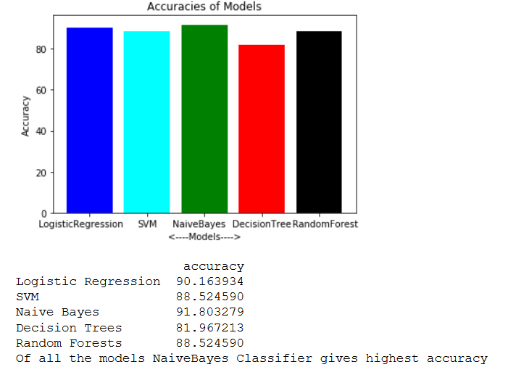
MODEL ACCURACY GRAPH:

Slide 18
MAPPING OF PO’S:
CO1: To help physicians to identify patients who are more prone to heart diseases.
CO2: To provide better health care and medications to patients by making predictions beforehand.
CO3: To provide solution for reducing the rising cost of healthcare and establish a better patient – doctor relationship.
PROGRAM OUTCOMES
 | PO1 (engineering knowledge) | PO2 (problem analysis) | PO3 (design/development of solution) | PO4 (conduct investigations of complex problems) | PO5 (modern tool usage) | PO6 (engineer and society) | PO7 (environment and sustainability) | PO8 (ethics) | PO9 (individual and team work) | PO10 (communication) | PO11 (project management and finance) | PO12 (lifelong learning)
CO1 | 3 | 3 | 3 | 3 | 3 | 3 | 3 | 3 | 3 | 3 | 3 | 3
CO2 | 3 | 2 | 3 | 3 | 3 | 3 | 2 | 2 | 3 | 3 | 3 | 3
CO3 | 3 | 2 | 3 | 2 | 3 | 3 | 2 | 2 | 3 | 3 | 3 | 3
PROGRAM SPECIFIC OUTCOMES
 | PSO1 | PSO2
CO1 | 2 | 3
CO2 | 2 | 3
CO3 | 2 | 3

Slide 19
Timeline
Stages | Time Required
1. Problem identification and definition. | 1 week(NOVEMBER)
2.Collection of the related articles and requirements. | 2 weeks(DECEMBER)
3.Contact guide and gathering data. | 3 weeks(DECEMBER,JANUARY)
4.Building a model for proposed work. | 3 weeks(JANUARY)
5.Implementation , testing , results, and analysis. | 3 weeks(FEBRUARY)
6.Documentation, preparation and submission. | 2 weeks(MARCH)

Slide 20
THANKYOU

